Slide 1
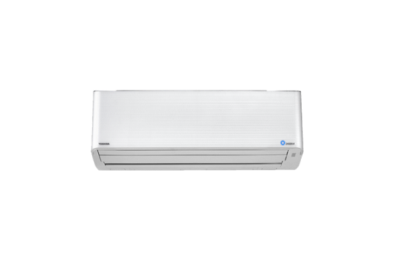
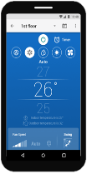
WIRELESS INTERFACE
This document is strictly confidential to its recipients
in TCC and should not be copied, distributed or reproduced in whole or in part.
HOW TO ADD AIR CONDITIONERS
TOSHIBA Home AC Control
IoT
By TCTC

Slide 2
Wireless adapter connectivity
A user can control up to 10 ACs
One AC can be controlled by maximum 5 users
All 5 users can control all 10 ACs

Slide 3
How to add AC?
5 user control 1 AC
By Using the same register email address
Register Email address | User name | Password | Wireless adapter | Remark
Father@toshiba | Father1 | a12345 | No.1 - 10 | Need to add AC
Father@toshiba | Mother1 | b12345 | No.1 - 10 | Can set different user name and password, No need to add AC, Automatically pair
Father@toshiba | Peter1 | c12345 | No.1 - 10 | Can set different user name and password, No need to add AC, Automatically pair
Father@toshiba | Sarah1 | d12345 | No.1 - 10 | Can set different user name and password, No need to add AC, Automatically pair
Father@toshiba | Jean12 | e12345 | No.1 - 10 | Can set different user name and password, No need to add AC, Automatically pair

Slide 4
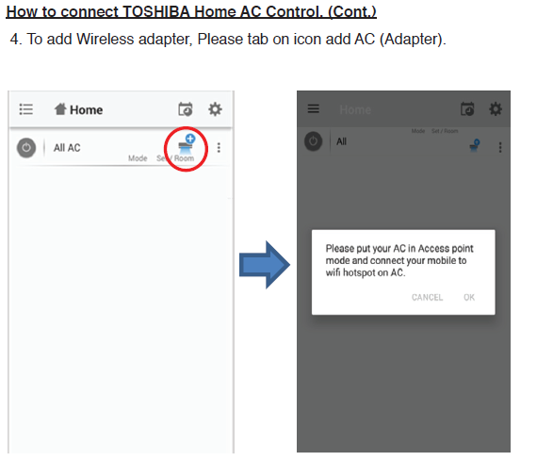
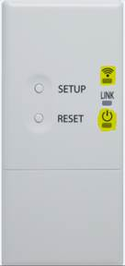
Add AC 1st time
When first time adding AC please follow installation manual and make sure you wireless adapter is AP mode(Access point mode 2 LED will on)
AP mode
Add AC
If the wireless adapter is not in AP mode press “SETUP” button 1 time
AP mode
AP mode 2 LED will on

Slide 5
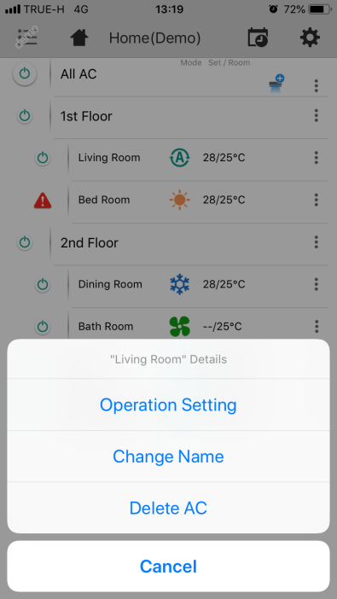
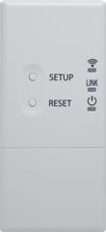
Re-add AC : Problem case
Re-add AC when change Wi-Fi router or Change register email address or Change wireless adapter to use with another A/C
When user re-add AC(wireless adapter) after 1st paring
Delete AC from mobile app
AP mode
Add AC
By press “SETUP” button until AP mode
You might need to press “SETUP” button several time until AP mode
( 2 LED on),
because of adapter keep retry connected to Cloud
Failed due to server and adapter still keep sending old provisioning signal
AP mode
1
Special mode
And some time all 3 LED on happened, must press “RESET” and try to repress “SETUP “again
2

Slide 6
Re-add AC : Correct method
TCTC recommendation re-add AC method
When user re-add AC(wireless adapter) after 1st paring
Factory reset + AP mode
Delete AC from mobile app
Add AC
By pressing “SETUP” button and hold for 5 seconds. Immediately release when all 3 LED ON
all 3 LED will show for
3 seconds, then automatic go to AP mode
Add AC complete
AP mode
1
Press SETUP too long time
*** if press until all 3 LED ON for long time adapter will go to test mode then LED will not change the state to AP mode. This case press RESET ***
2

Slide 7
Re-add AC : Backup method
Incase of Adapter already deleted from mobile app without any Factory reset first
Add AC
When user re-add AC(wireless adapter) after 1st paring
Delete AC from mobile app
AP mode
Factory reset
By press “SETUP” button until AP mode
all 3 LED will show for
3 seconds, then automatic go to AP mode
By pressing “SETUP” button and hold for 5 seconds. Immediately release when all 3 LED ON
You might need to press “SETUP” button several time until AP mode
( 2 LED on),
because of adapter keep retry connected to Cloud
AP mode
AP mode
1
Special mode
And some time all 3 LED on happened, must press “RESET” and try to repress “SETUP “again
Press SETUP too long time
*** if press until all 3 LED ON for long time adapter will go to test mode then LED will not change the state to AP mode. This case press RESET ***
2

